Slide 2
Title
Body
Notes:
Change photo – keep it short and sweet

Slide 3
Title
Body
Notes:
Change photo – keep it short and sweet

Slide 4
Continuum of Care
Residential
Co-Occurring Treatment
Co-Occurring Intensive Outpatient
with Lodging
Co-Occurring Intensive
Outpatient
Program
Sober
Living
Homes
Notes:
Our Continuum of Care
Don’t need to use if you don’t have it

Slide 5
Body
Title
Notes:
For picture - NSR logo if you can’t find a good photo

Slide 6
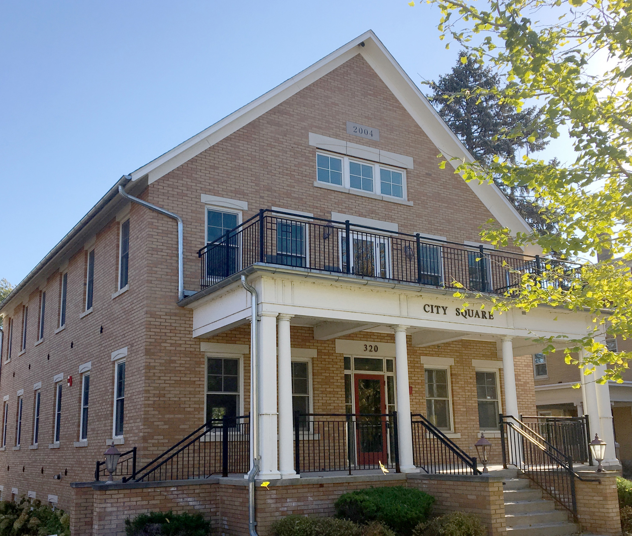
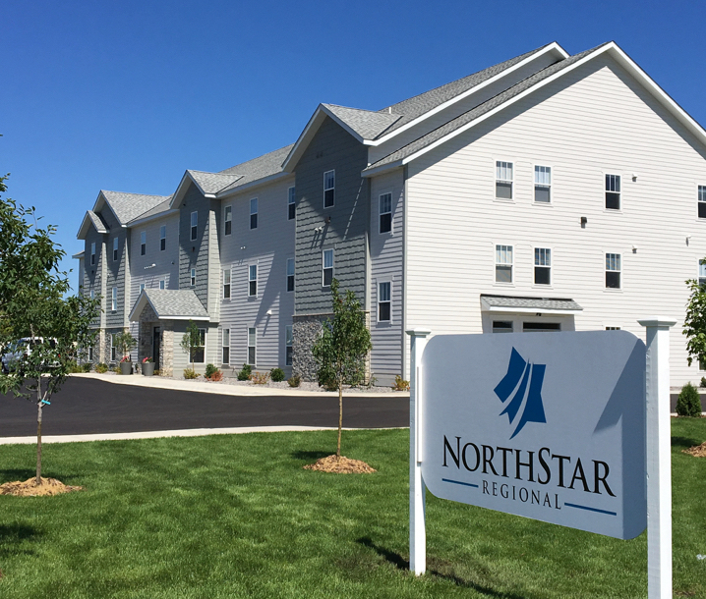
Title
Description too
Description of picture
Description of picture
Notes:
More for pictures and describing NSR

Slide 7
1-833-NSR-HOPE (1-833-677-4673)
Fax: 763-225-4470
Online: https://northstarregional.com/bed-availability/
Latest in housing availability across all NorthStar Regional locations.
Email: Admissions@NorthStarRegional.com
https://northstarregional.com/
Notes:
Contact us soon

Slide 8
How Can We Help?
Recovery looks different for everyone, and we’re
here to help your clients find the right path.
Notes:
How Can we Help You and Your Clients?

