Slide 1
Mend one’s way, reform one’s self.
We welcome those, detox those, treat those, and provide a sense of community to those struggling with substance use disorders and mental health.
St. Paul | Bloomington | Bemidji | Telemedicine

Slide 2
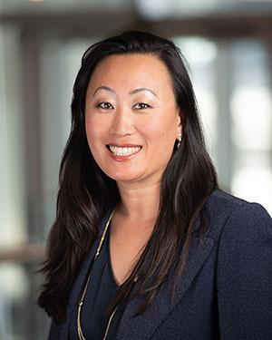
Our Founder: Alana Sasaki, MD
Founder and CEO of Kai Shin Clinic
Attended John A Burns School of Medicine, the University of Hawaii, and residency at the University of Minnesota St Joseph’s Family Medicine Residency
Attending addiction specialist at St Josephs MICD Inpatient Unit
Lead Addiction Physician at Allina Health, detox unit
Fellow in the American Society of Addiction Medicine
Diplomate of the American Board of Addiction Medicine and the American Board of Family Medicine
Extensive experience managing all continuums of care in addiction, from the most complicated detoxes, inpatient and outpatient services

Slide 3
Addiction
20 million Americans have a substance use disorder
46 million Americans have a mental health disorder
Without access to proper care, individuals with an SUD or MH disorder are at risk of criminal justice involvement, overdose death, harming themselves and others, repeat emergency room visits, and mental health hospitalizations.
Overcoming addiction is not simply a matter of willpower.
1 in 5 Americans live with a SUD or MH disorder

Slide 4
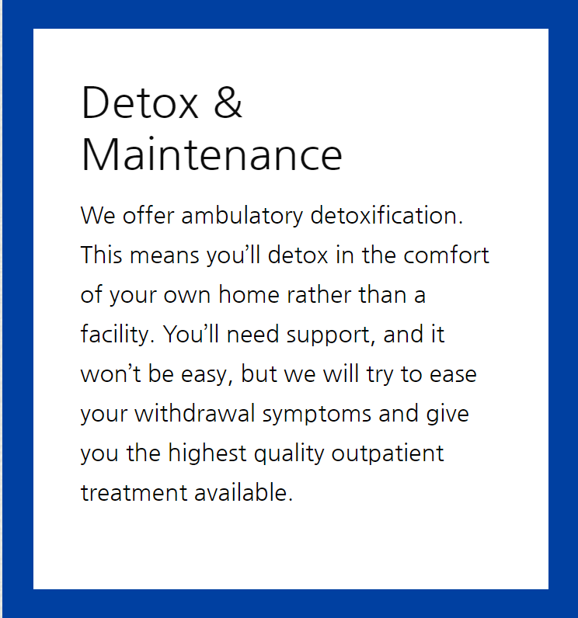
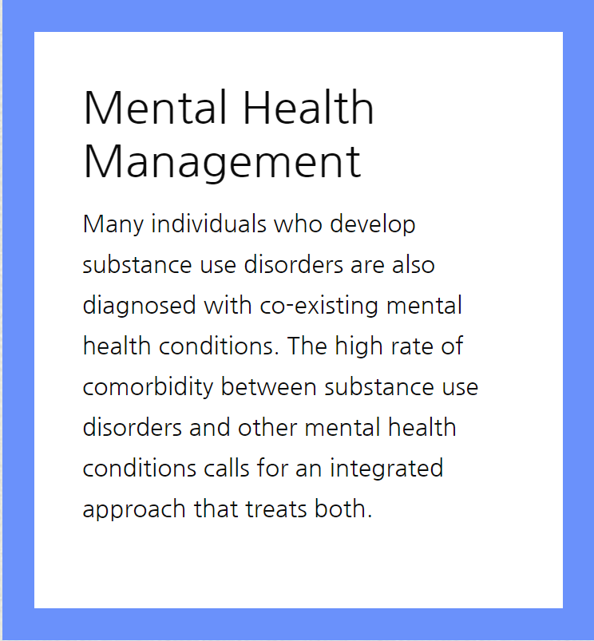
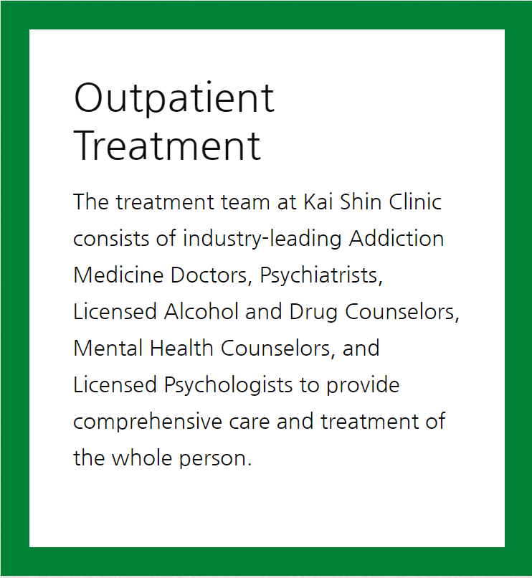
Services

Slide 5
Services
Medication Management
Mental Health Management
Psychological Testing
Outpatient Treatment
Detox & Maintenance
Drug Testing & Laboratory
Addiction Assessments
Telemedicine
Same Day Appointments

Slide 6
What do we treat?
Substance use disorders - all drugs
Anxiety disorders
Schizophrenia
Bipolar disorder
Personality disorder
Major depressive disorder
Post-traumatic stress disorder
Attention deficit hyperactivity disorder

Slide 7
Patient Experience
Consult with Physician
Detox in clinic (ambulatory)
Start on medications
Address Mental Health
Attend outpatient treatment
1
2
3
4
5
Weekly visit with physician
Weekly drug testing
Possible vivitrol injection
Taper off medication
6
7
8
9

Slide 8
Medication Assisted Treatment: What is it?
The use of FDA approved medications in combination with counseling and behavioral therapies for the treatment of substance use disorder.
Bridges the biological and behavioral components of addiction
Medications normalize brain chemistry
Relieve physiological cravings
Normalize body functions
Removes extreme withdrawal effects
Kai Shin can treat any drug disorder
Do not prescribe methadone
Suboxone, Naltrexone, Buprenorphine, Campral
MAT medications have shown a reduction in the death rate among those living with addiction by 50% or more
Up to 90% of patients who participate in MAT maintain sobriety at the 2 year mark

Slide 9
Drug Testing
CAP Accredited Laboratory
Clinical and Forensic Testing
Test for over 25 substances and 70+ analytes
All patients are drug tested
Results provided in case management records
Provided to courts/legal representation

Slide 10
Forms of Payment Accepted
Self Pay
Private Insurance - Accept all MN insurance
Medical Assistance

Slide 11
Partnership Opportunities
Client consultation upon intake
On site support staff
MAT services/suboxone/vivitrol
Ambulatory detox
Psychiatric medications
Drug testing

Slide 12
Locations
Bloomington
7831 Glenroy Road
St. Paul
777 Raymond Ave
St. Paul
1919 University Ave
Bemidji
705 5th Street
Telemedicine
Statewide Coverage

Slide 13
Referrals
Call today. Begin tomorrow. 651-447-3755
www.kaishinclinic.com
info@kaishinclinic.org
Jessica Wong
612-702-0961
jessica.wong@kaishinclinic.org

